Slide 1
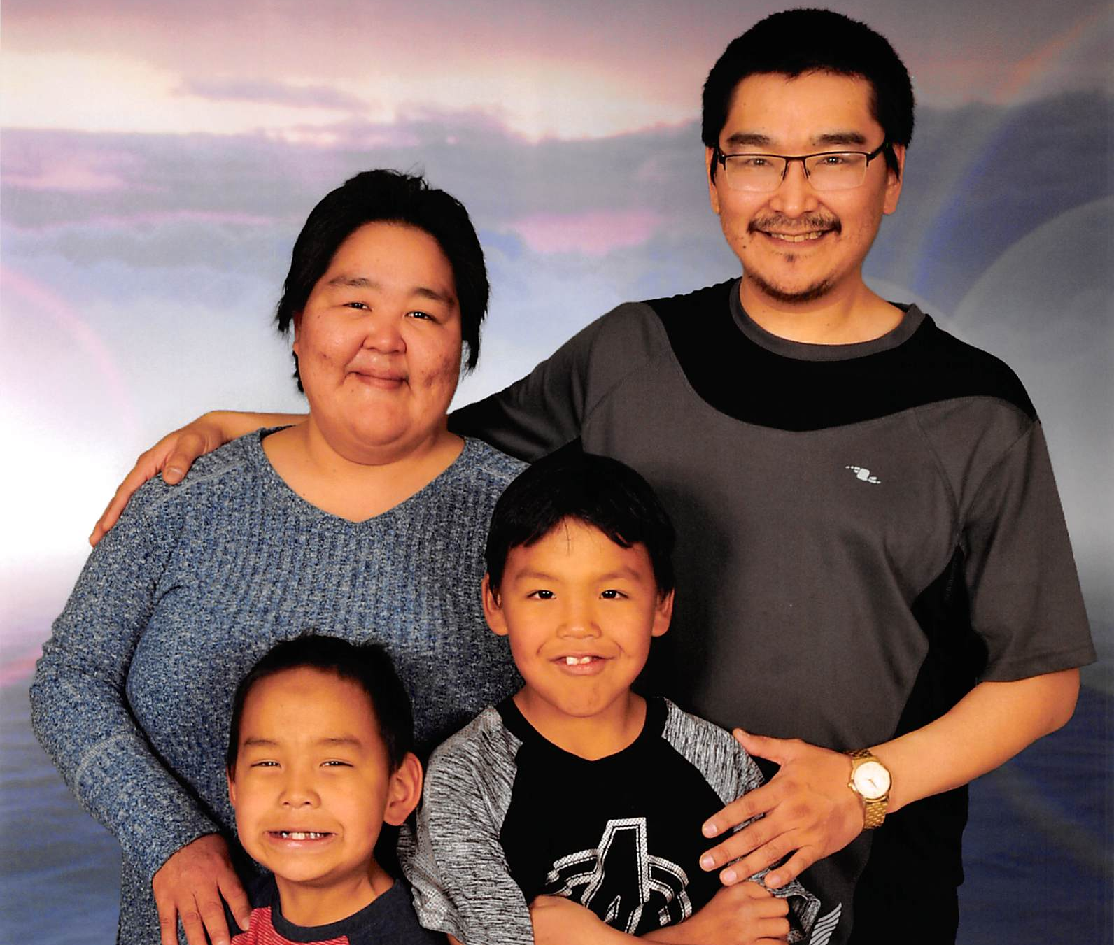
Johnny Ugjuk
Born to be a deaf person

Slide 2
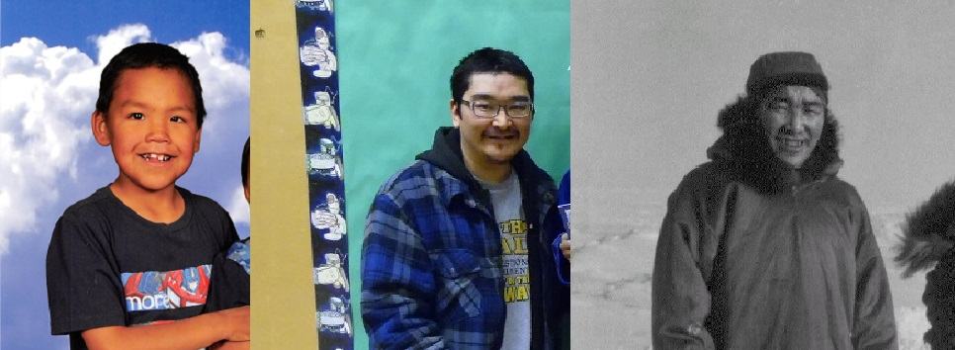
Accessibility Week
Johnny have been taught and inspired that my former teachers and student support assistants said that the disabilities rights movement is a global social movement to secure equal opportunities and equal rights for all people with disabilities. Disability activists are working to break institutional, physical, and societal barriers that prevent people with disabilities from living their lives like other citizens

Slide 3
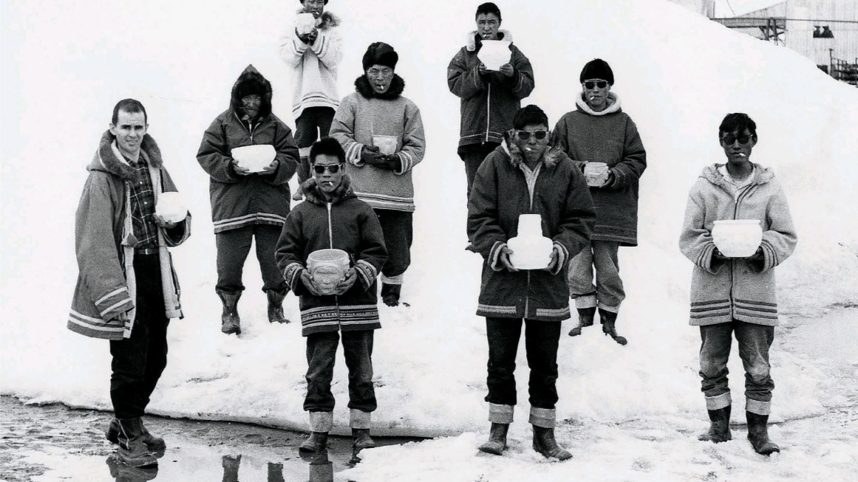
Can disabled people be successful?
Yes, if people are working with a person who is a disabled, they help to enable them to learn first and follow their lead, they are the experts on their needs and how to best meet them. If they do ask for help, ask for specific instructions on how you can help, next level; learn how to write and read, and told to watch and learn very well. teachers and student support assistants have completed them, and they are succeeding in their journey. The disabled person moving on without need help from teachers and student support assistants, it is their own journey to challenge the globe of a new interests to gain more knowledge about the people with their differential cultural and traditional.

Slide 4
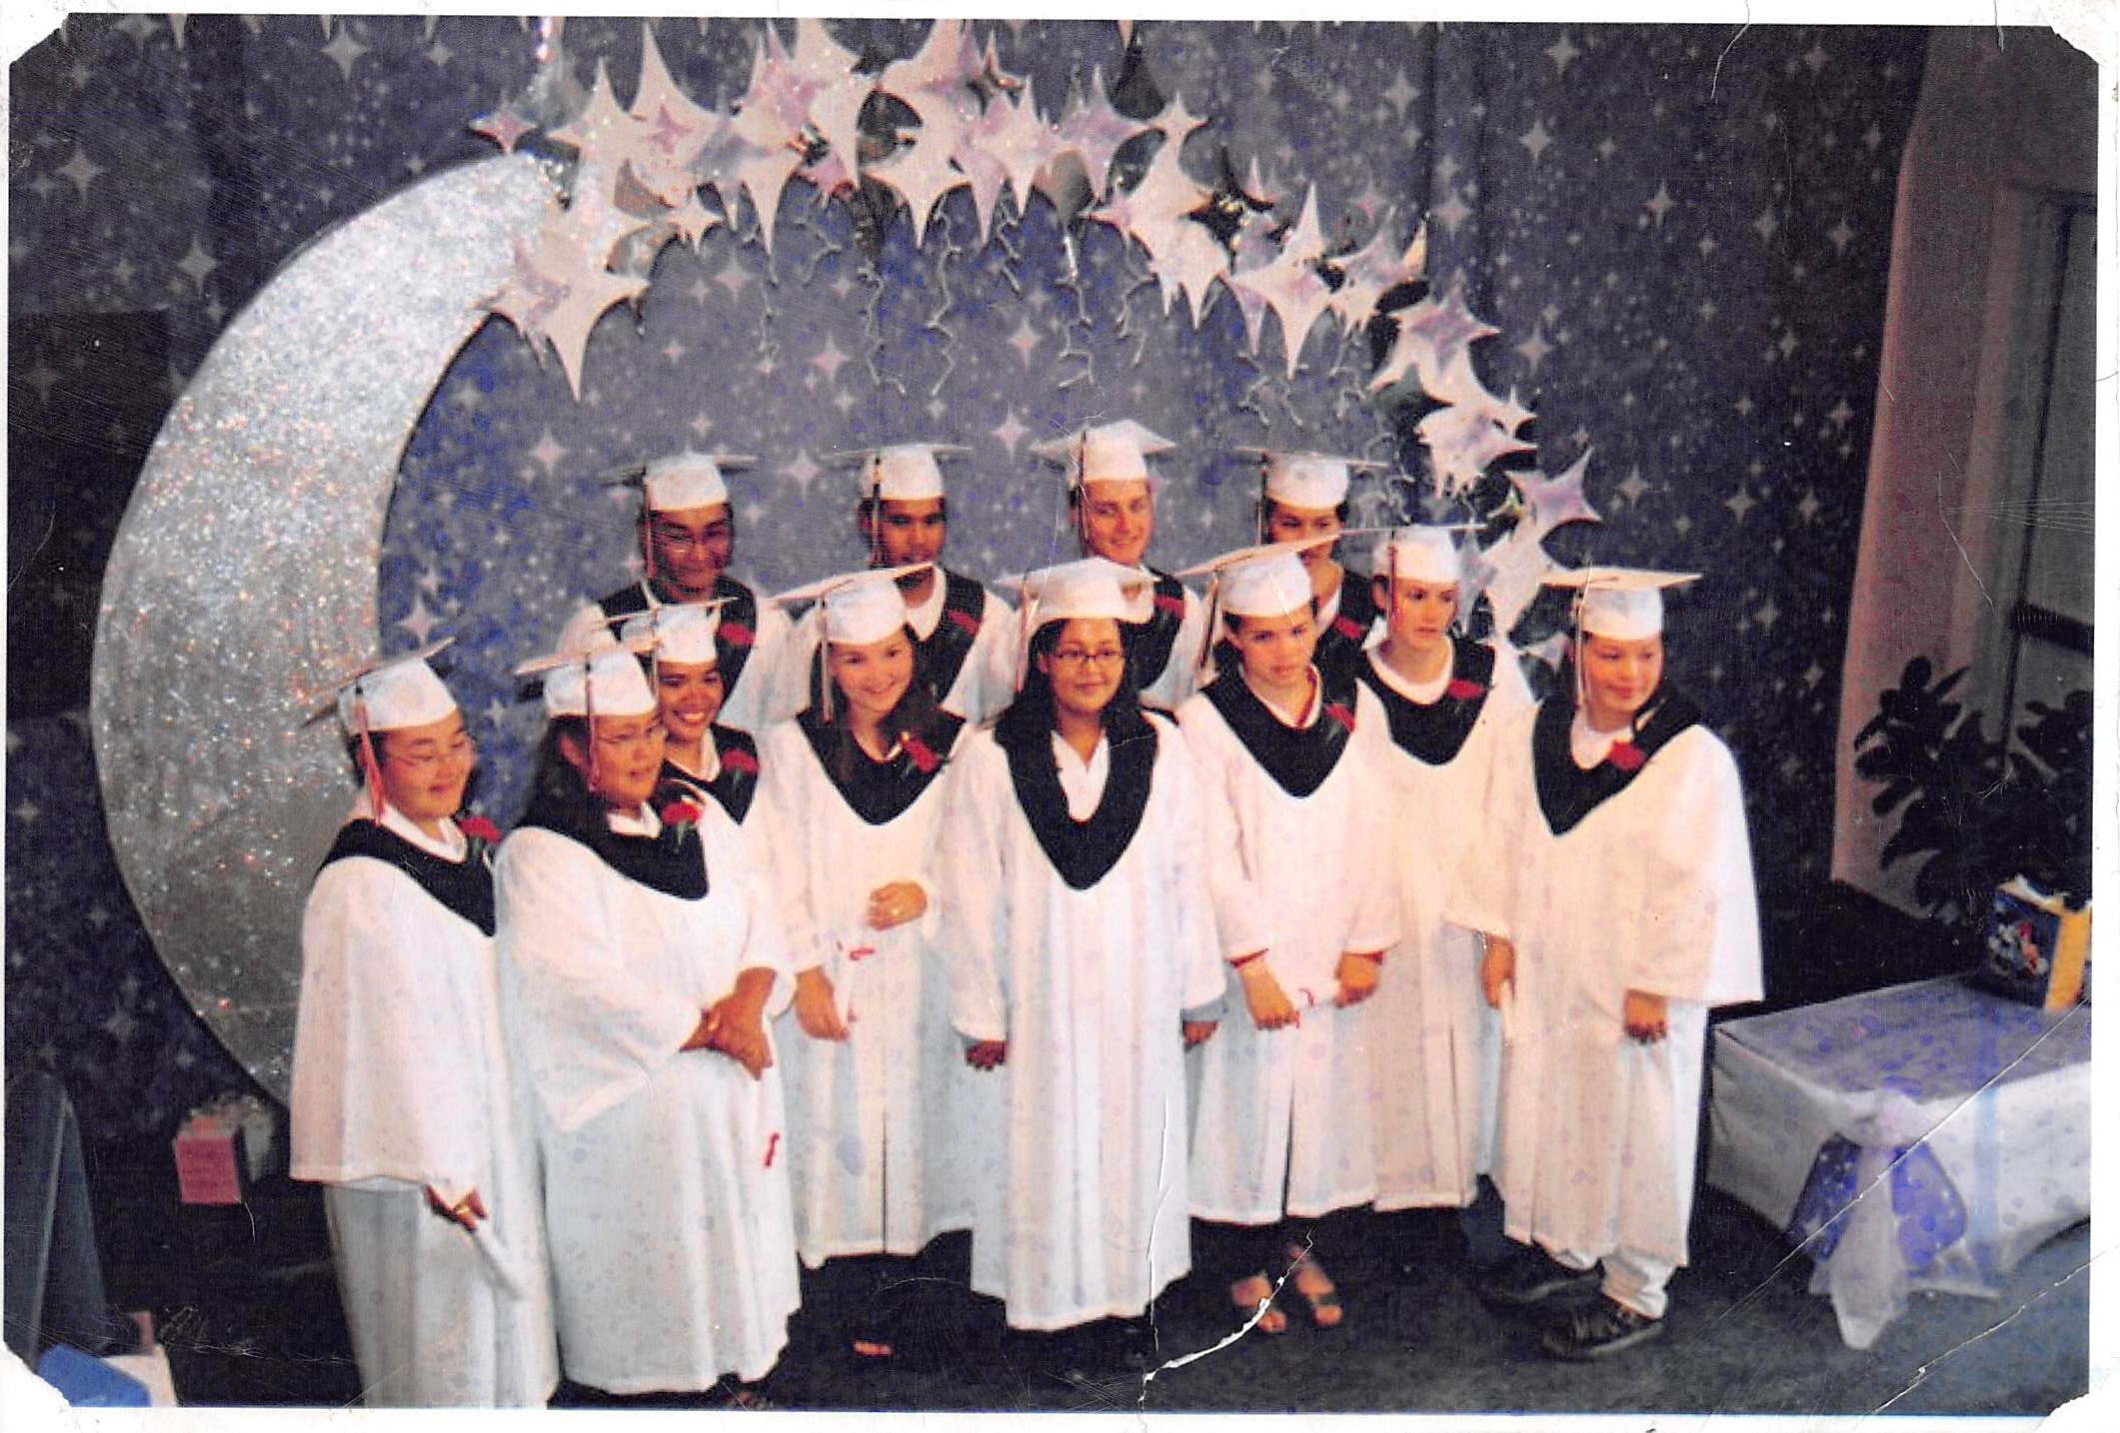
How Do disabilities Start The Journey Without Getting Help From Others?
The disabled person is continuing their successful trips in a different way to meet the best interests ahead of them. And the disabled person can pass their skilled to other disabilities who are unable to do so, they can push them to the limits to unlimited from failure to success.

Slide 5
Thank You,
NUNAVUMMI DISABILITIES MAKINNASUAQTIIT SOCIETY We all do better, all together!

